Slide 1

Heart Failure Survival Analysis
2026 Michigan Data Science Team Project
Sina Bonakdar
Terry Zhang

Slide 2
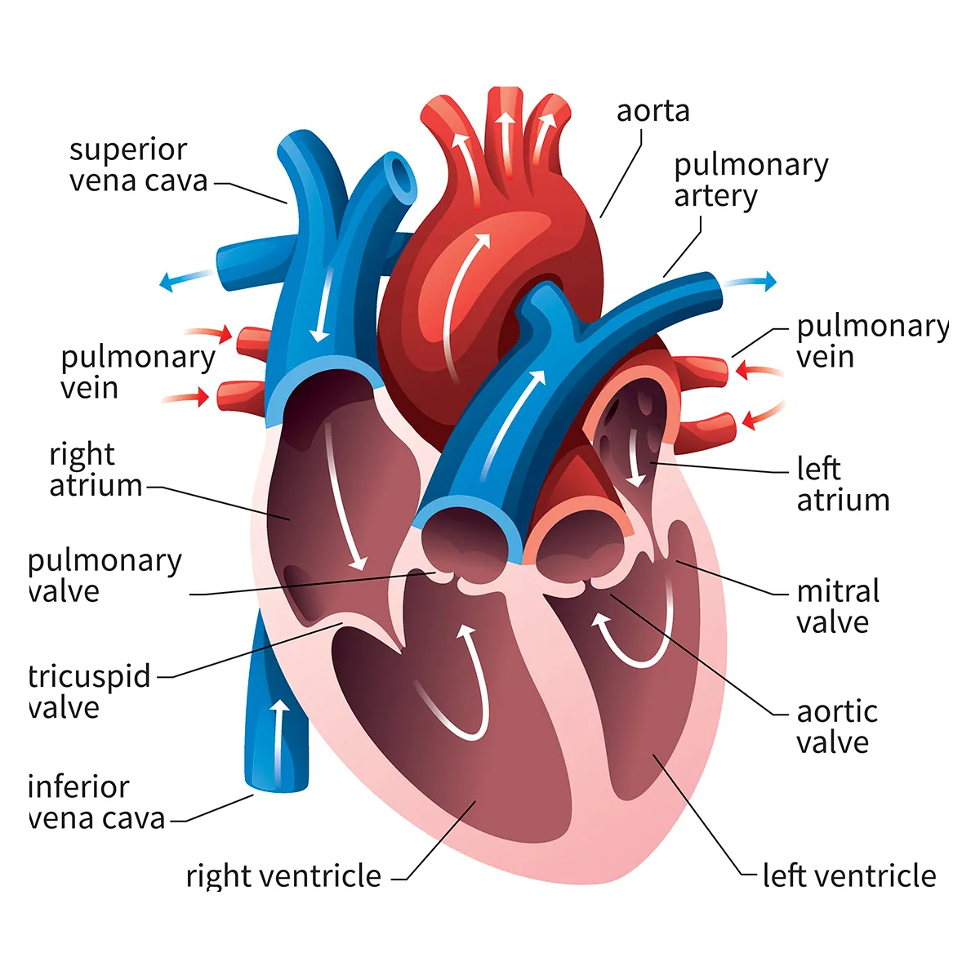
Heart Failure Survival Analysis
What is Heart Failure?
  When the heart cannot pump sufficient blood
  Not all heart failures lead to death.
Two types of heart failure:
  Reduced ejection fraction (<40% ejection fraction), indicating ineffective heart contraction
  Preserved ejection fraction (left ventricle is stiff and cannot relax and fill properly)
Goal:
a) Use machine learning and deep learning classifiers to predict survival event in heart failure patients
b) Identify the most critical parameters affecting survival→provide insights to physicians to tailor treatments more effectively and reduce mortality
Our focus
Notes:
Ejection fraction: is the percentage of blood that heart pumps out.
Low oxygen blood from body → right atrium → right ventricle → lung
High oxygen blood from lung → left atrium → left ventricle → body

Slide 3

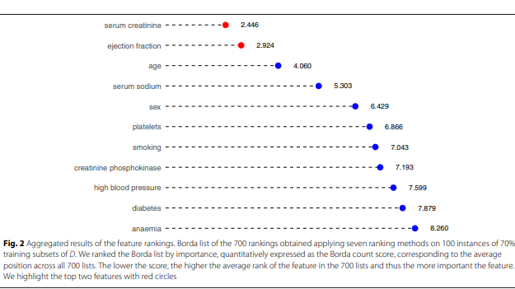
Paper Acknowledgment
Machine learning models can predict survival of patients with heart failure using serum creatinine and ejection fraction alone (Chicco & Jurman, 2020).
With only two features, Random Forest reached 84% accuracy predicting survival rate, which was very close to the performance using all features.
Serum creatinine: a blood measure related to kidney function.
Ejection fraction: a measure of how well the heart pumps blood.
Notes:
Ejection fraction: is the percentage of blood that heart pumps out.
Low oxygen blood from body → right atrium → right ventricle → lung
High oxygen blood from lung → left atrium → left ventricle → body

Slide 4
Dataset description (Week 1)
Dataset: 299 heart failure patients
13 clinical features, tabular, no missing value, imbalance labels
Features: Demographic, lifestyle factors, and critical health indicators→ Both Binary and Continuous variables
Target feature: “death event” tracks patient survival in 130 days
1 → Patient died during follow-up
0 → Patient survived
Survived | Died
203 | 96
Notes:
CPK enzyme

Slide 5
Feature Explanations
Anemia- Deficiency of red blood cells (<36%)
Creatinine PhosphokinaseEnzyme levels that increase when muscle tissue is damaged. High levels may indicate heart failure or injury.
Ejection Fraction:states the percentage of how much blood the left ventricle pumps out with each contraction.
Serum creatinine:a waste product generated by creatine, when a muscle breaks down. Especially, doctors focus on serum creatinine in blood to check kidney function. If a patient has high levels of serum creatinine, it may indicate renal dysfunction
Serum sodium:a mineral that serves for the correct functioning of muscles and nerves. The serum sodium test is a routine blood exam that indicates if a patient has normal levels of sodium in the blood. An abnormally low level of sodium in the blood might be caused by heart failure.
Age: age of the patient
Sex: woman (0) or man (1)
Time: number of Follow-up times
Smoking: if the patient smokes (1), if not (0)
Platelets: number of platelets in the blood
High blood pressure: Yes (1), no (0)
Diabetes: Yes(1), no (0)

Slide 6
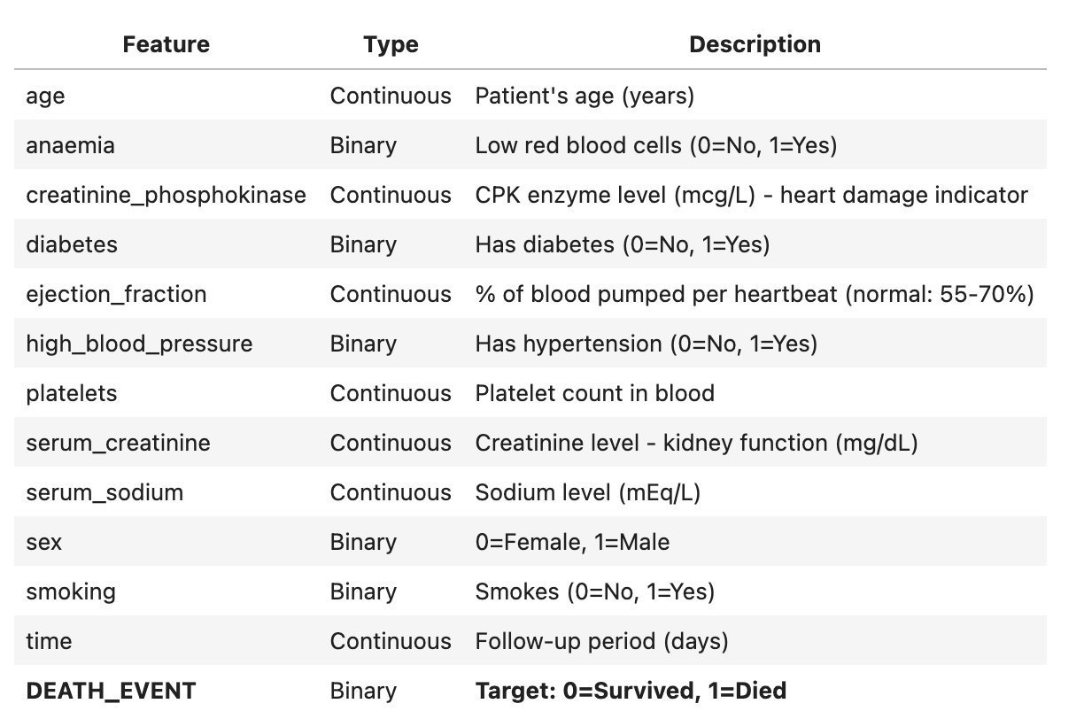
Feature Explanations

Slide 7
Methods
Python (Numpy, Pandas, SciPy, Scikit-learn, Matplotlib, Seaborn,PyTorch, TensorFlow)
Data preprocessing
Feature selection (e.g., Elastic Network, MRMR)
Data Visualization
Statistical Analysis (e.g. correlation, significance test)
Unsupervised learning to uncover data structures (e.g. PCA, k-means)
Supervised learning classifiers will be used for Binary classification (e.g. random forest, logistic regression, SVMs,XGBoost, Neural Network)
Use different evaluation metrics for evaluation of ML models (e.g. F1, AUC, Accuracy)
Use ML Interpretation tools to interpret from our predictions (SHAP, PLSDA)

Slide 8
Accomplishments
Data Visualization
Data Explanation and Preprocessing
Statistical Analysis
Unsupervised Learning, Dimensional Reduction, and Confusion Matrix
Design Simple Machine Learning Algorithms
Evaluation Metrics

Slide 9
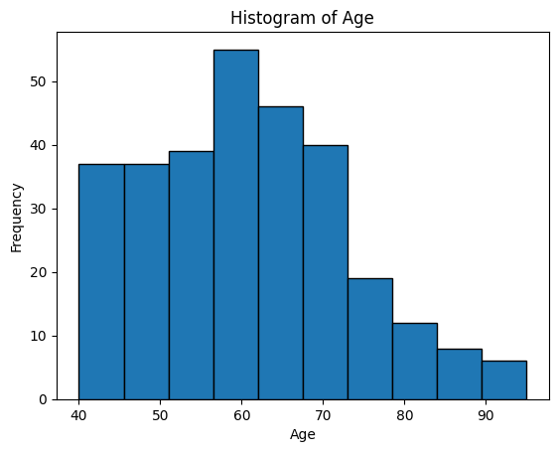
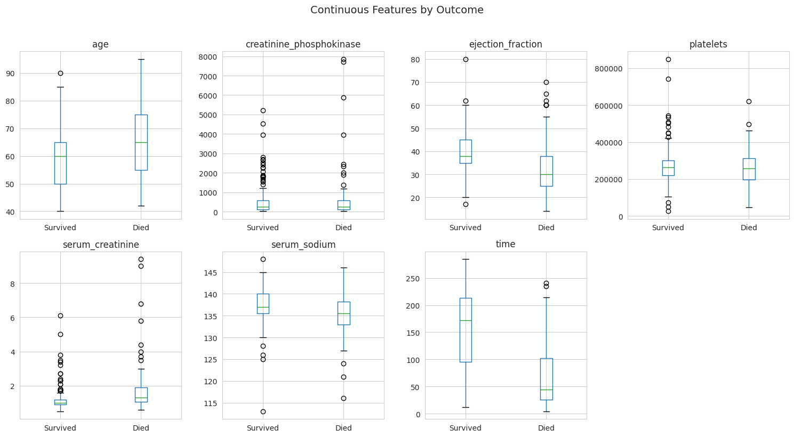
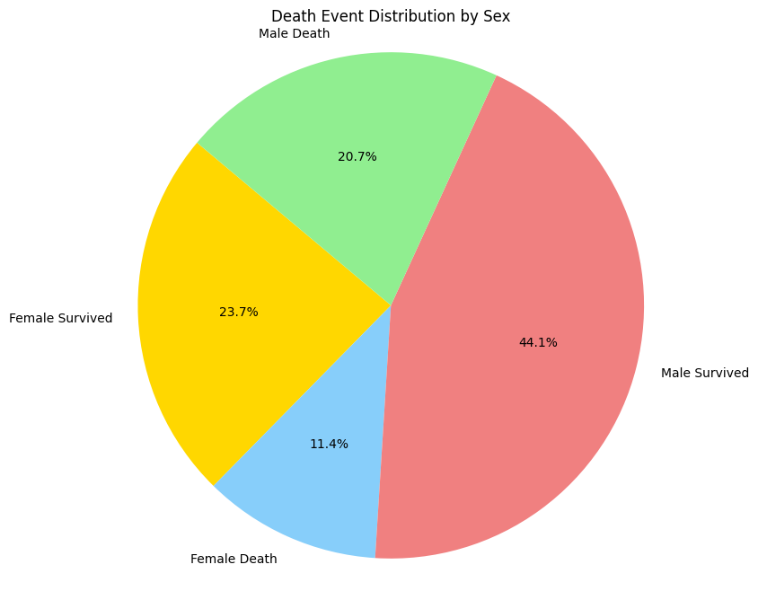
EDA, Data Visualization(Week 2)
Libraries:
Matplotlib
Seaborn
Get intuitive understand of datasets

Slide 10
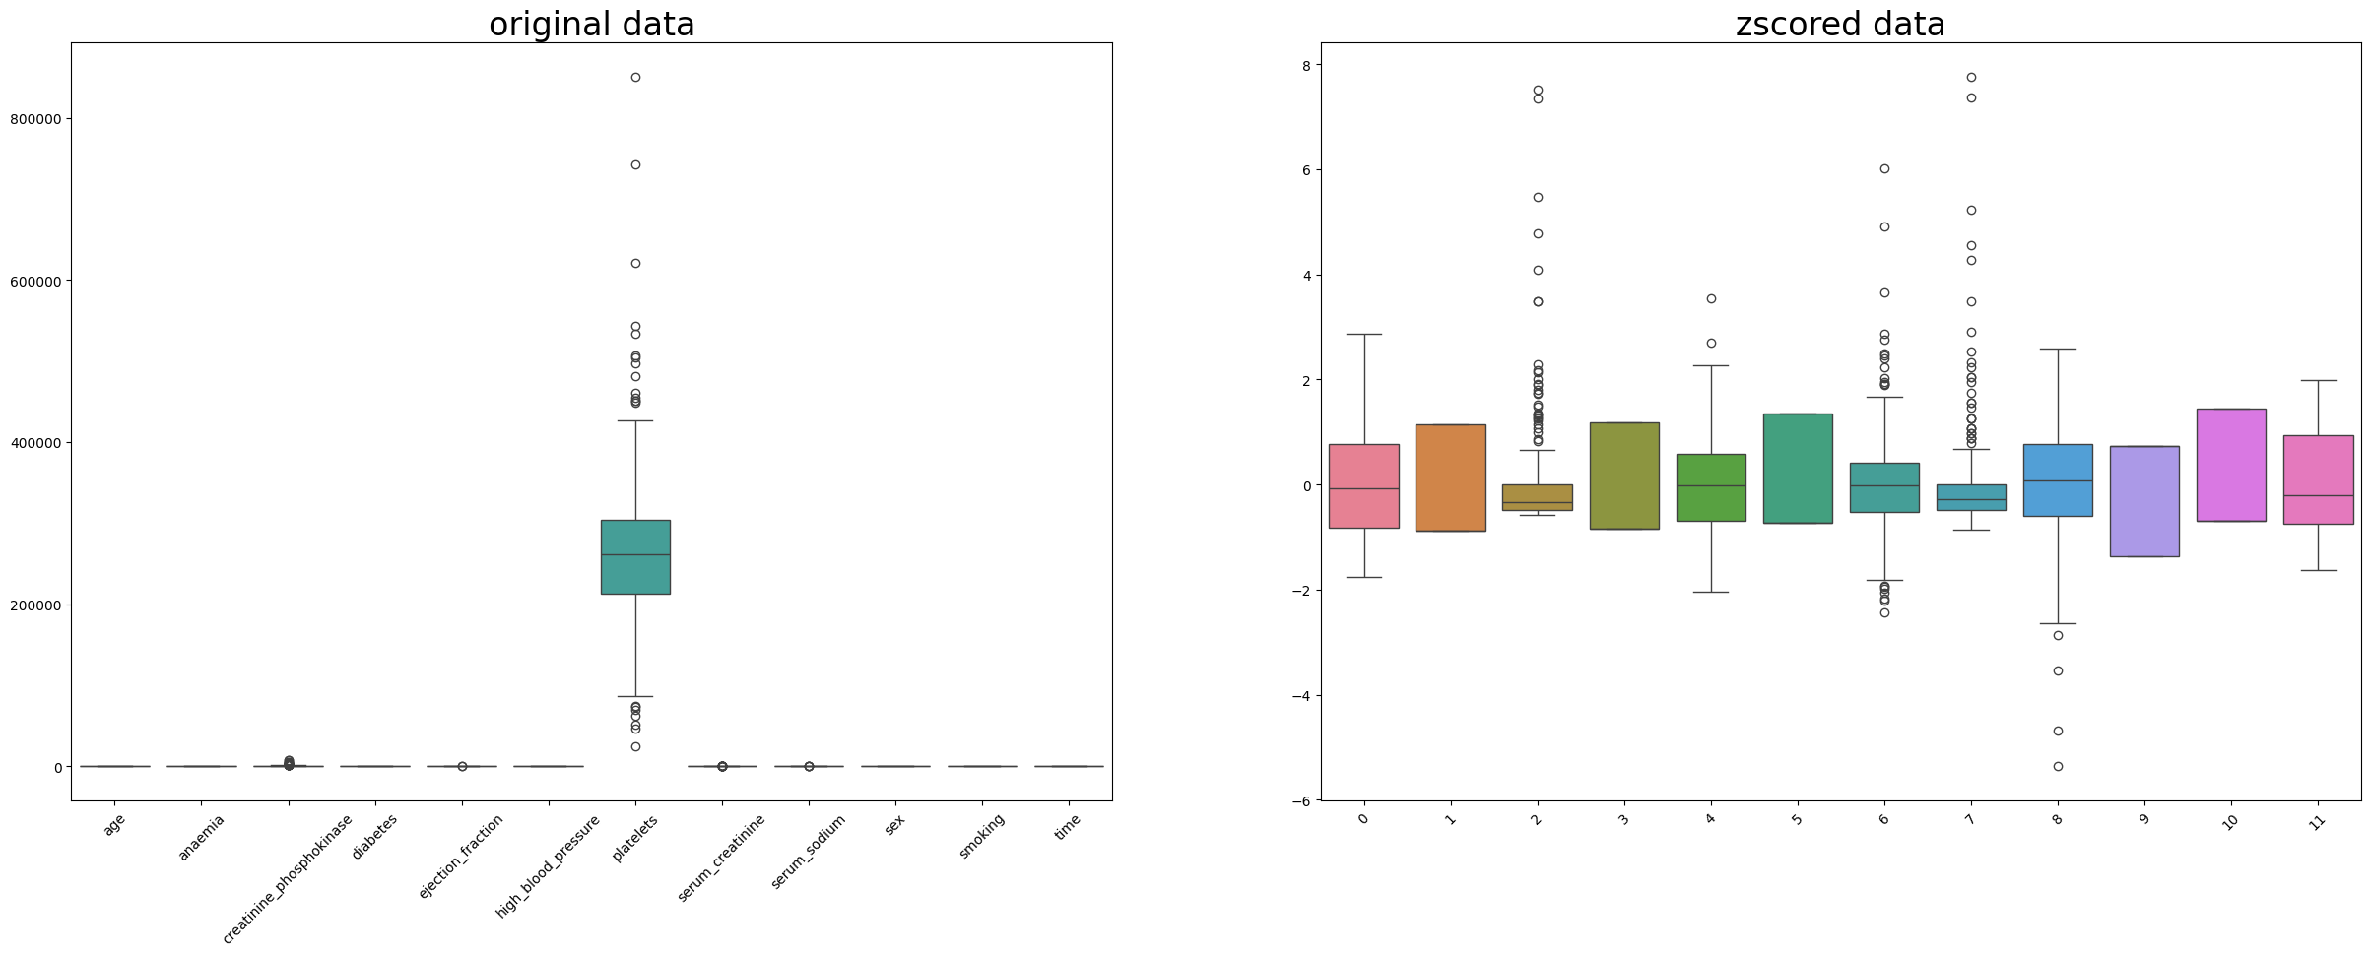
Data Explanation and Preprocessing
How to work with NumPy and Pandas.Dataframe
Data Normalization (zscore)

Slide 11
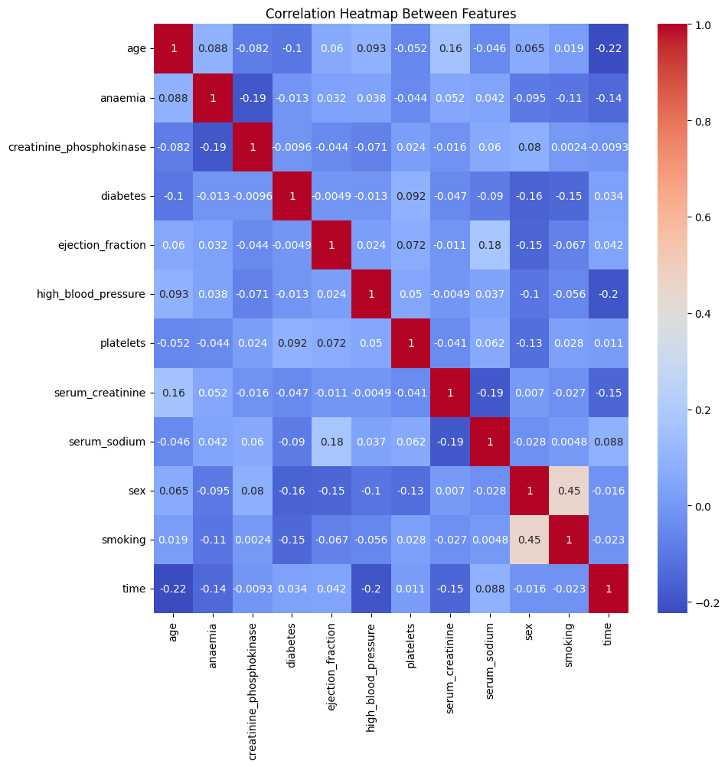
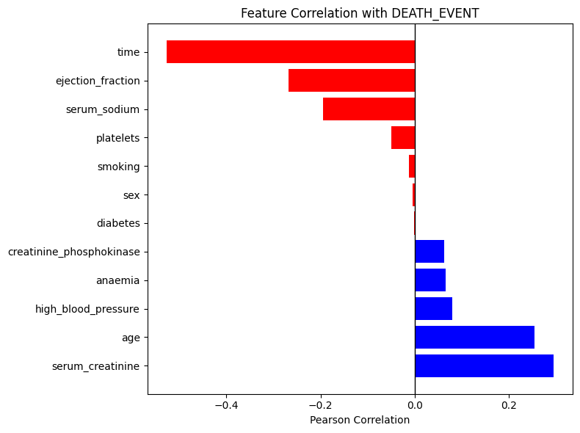
Statistical Analysis (Week 3)
Correlation between features
Correlation with the output

Slide 12
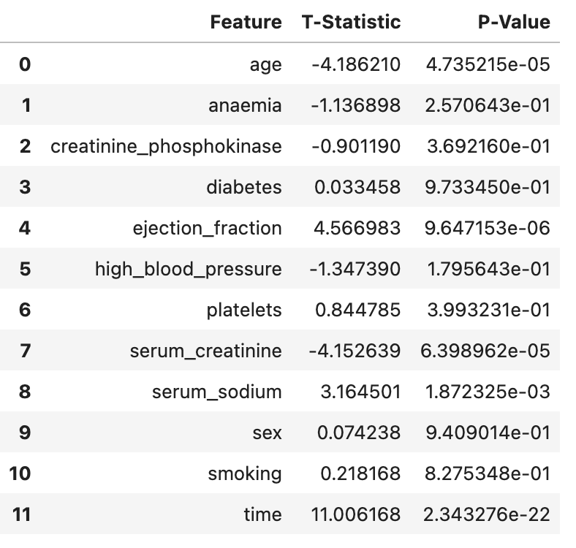
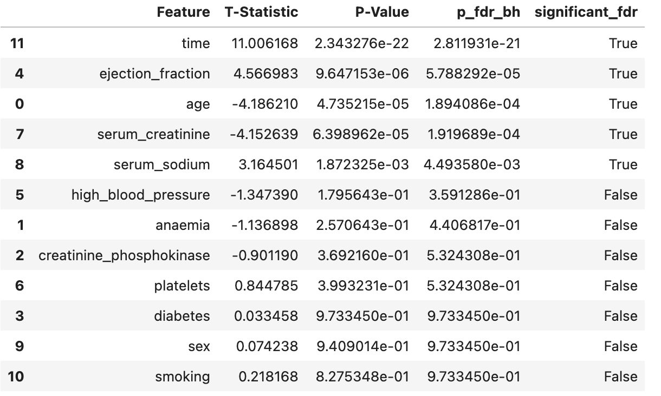
Statistical Analysis from SciPy
Mann-Whitney U test and Multiple Hypothesis Test
Two-sample t-test

Slide 13
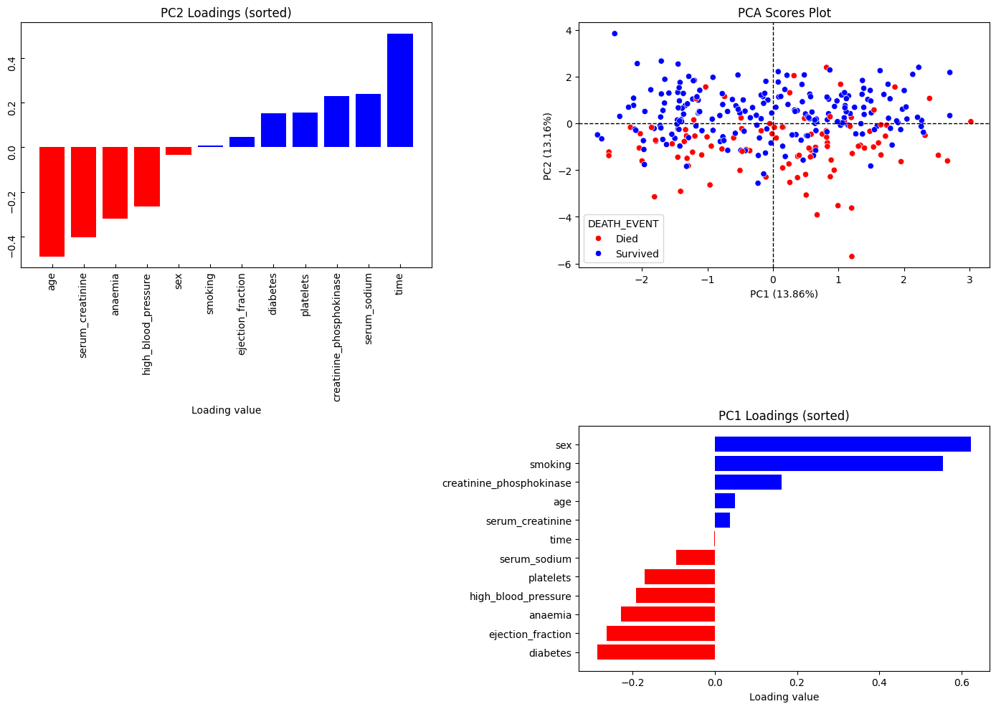
Unsupervised Learning, Dimensional Reduction, and Confusion Matrix (Week 4)
Principal Component Analysis

Slide 14
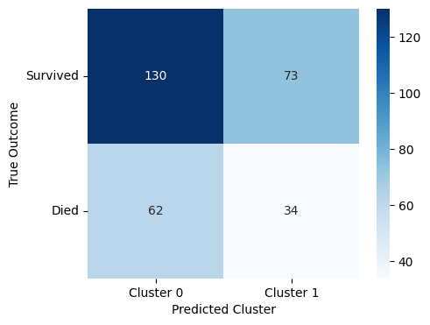
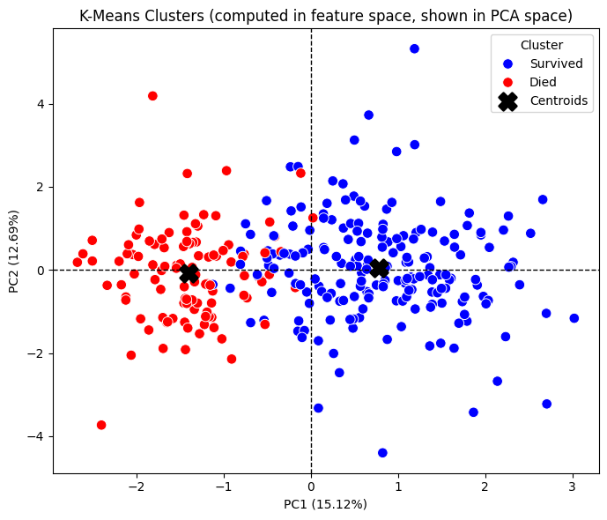
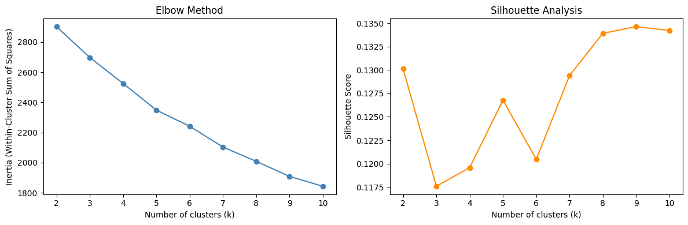
K-means Clustering
Condusion Matrix of K-means clusters
How to identify the optimal K-value?

Slide 15
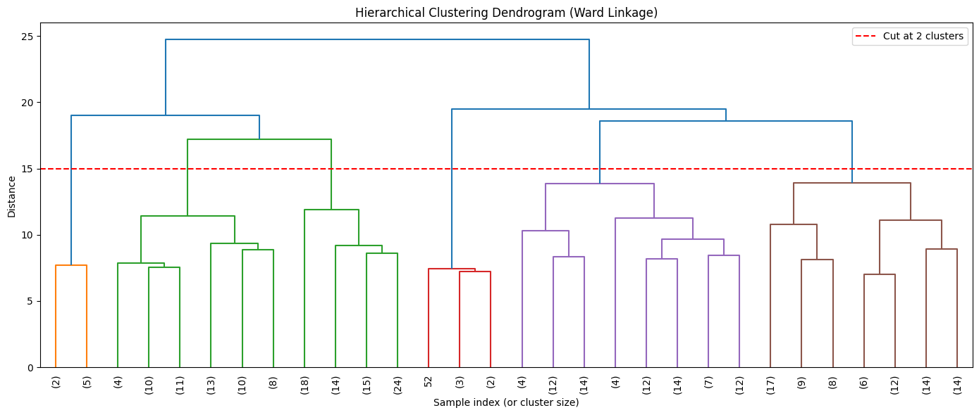
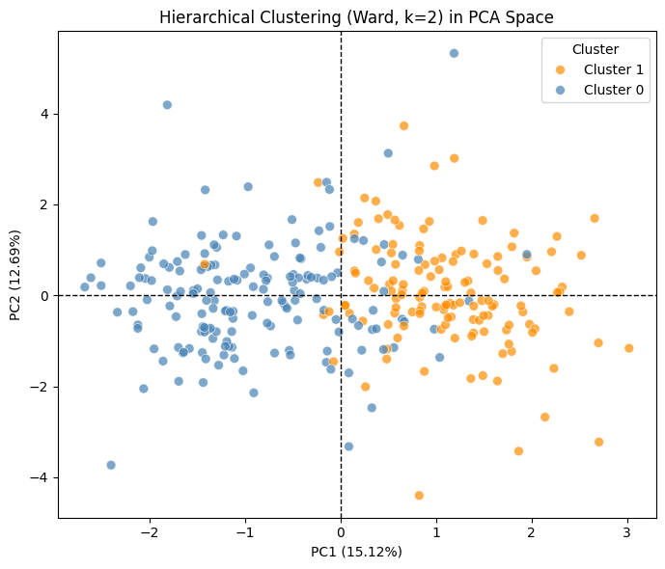
Hierarchical Clustering

Slide 16
Supervised Learning and Evaluation Metrics
Steps:
Create train-test split
Data Normalization
Model Training
Prediction on test set
Evaluation
Model Name | Accuracy | Precision | Recall | F1-Score
Dummy Model | 0.68 | 0 | 0 | 0
K-Nearest Neighbors | 0.67 | 0.47 | 0.28 | 0.35
Linear SVM | 0.7 | 0.55 | 0.41 | 0.47
Kernel SVM | 0.73 | 0.62 | 0.45 | 0.52
Random Forest | 0.72 | 0.58 | 0.52 | 0.55
Logistic Regression | 0.71 | 0.58 | 0.38 | 0.46

Slide 17
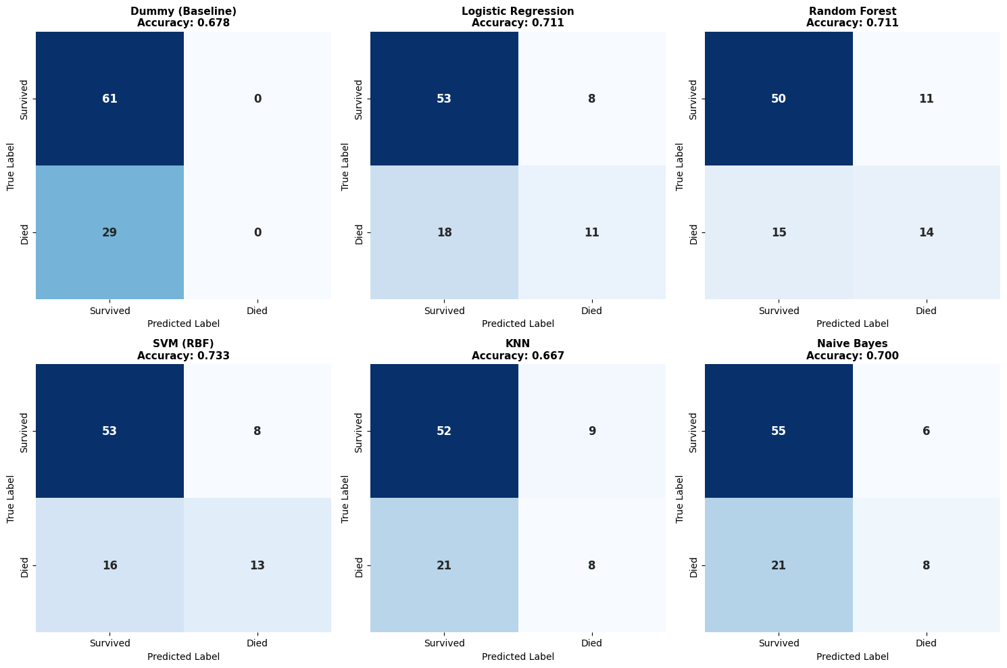
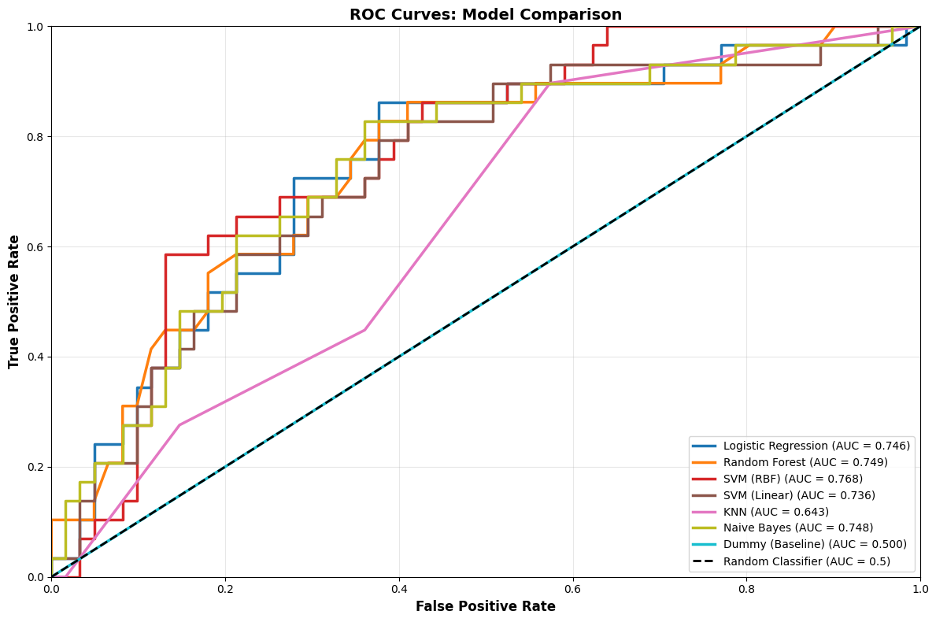
Supervised Learning and Evaluation Metrics
SVM (RBF kernel)
achieving the best performance at 73.33% accuracy and outperforming the baseline by 5.5 percentage points,
though Random Forest's higher recall (48.28%) may be preferable for medical applications.

Slide 18
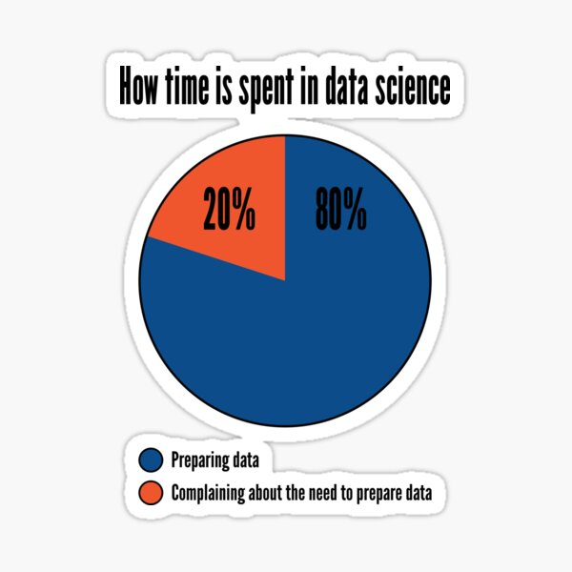


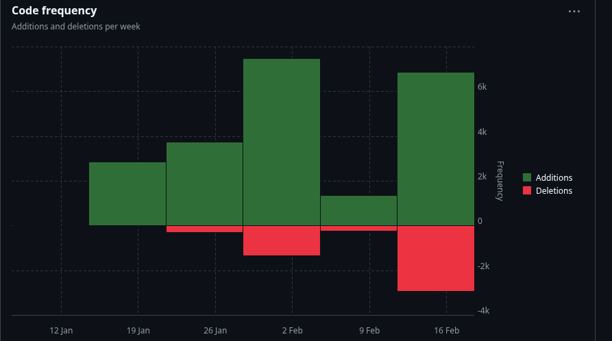

Next Steps
Model Optimization
  Hyperparameter Optimization
  Feature Selection
Cross-Validation
  K-fold
Neural Networks and Deep learning
  TabPFN
Model Interpretation
  SHAP
  PLS-DA
…...
Check our repo on GitHub!
Acknowledgment
@Sina2285 @katoue

